Slide 1
TRAVEL INSURANCE PROJECT PRESENTED BY: WICLIFF TAH ANGWAH OCCUPATION: DATA ANALYST AT TRAVEL ASSURED WHEN: 03/08/2022

Slide 2
TABLE OF CONTENTS
Introduction
Methodology
Results/Findings
Insights/conclusion

Slide 3
INTRODUCTION
Due to the COVID pandemic, travel insurance have had to cut their marketing budget by over 50%.
Hence this presentation is aimed at providing a marketing strategy such that advertisement is done to the right people and at the right places

Slide 4
METHODOLOGY
From the travel insurance data given, a split was made to compare travelling habits of customers and non-customers depending on whether they paid for insurance or not.
The marketing strategy devised was based on frequency of travel and occurrence of travel abroad.
Hence visualizations were based on employment type, annual income, graduate or non-graduates, number of family members and the presence of a chronic disease

Slide 5
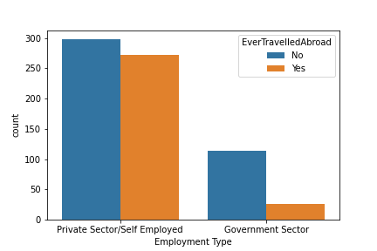
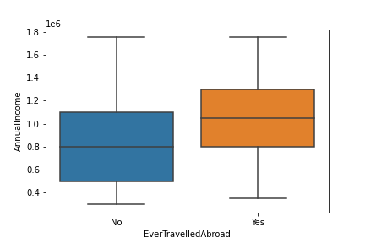
RESULTS/FINDINGS
Customers more likely to travel abroad
Non Customers more likely to travel abroad

Slide 6
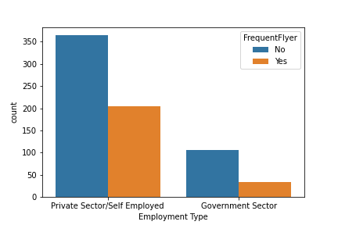
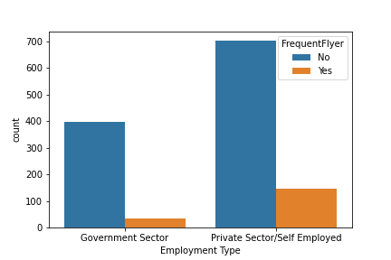
RESULTS/FINDINGS
Customers who travel frequently
Non Customers who travel frequently

Slide 7
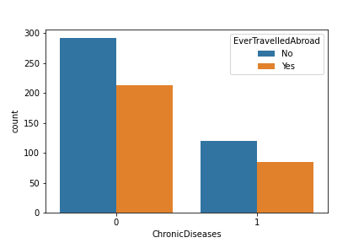
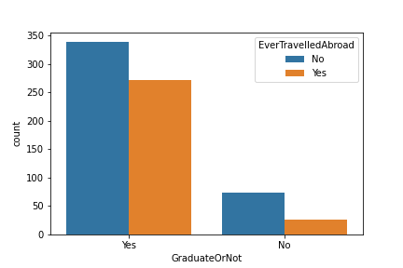
OTHER FINDINGS

Slide 8
INSIGHTS AND CNCLUSION
From the visualizations above, the insights gotten for the market strategy involved advertisement to the following people:
Private Sector/self employed workers
High Income earners
Graduates
Patients with Chronic diseases.

